Slide 1

Telco Customer Churn Predictive Modeling
Jeffrey Xu

Slide 2

What is the Problem?
Telecommunications companies experience significant revenue loss when customers cancel their services. However, it is often difficult for businesses to clearly identify which factors lead customers to leave and which customers are most at risk of churning.

Slide 3

How can we solve the problem?
We analyze Telco customer data to identify patterns and behaviors associated with churn. By applying exploratory analysis and predictive modeling, we aim to uncover the key drivers of churn and build a model that helps identify customers who are most likely to leave.

Slide 4
Dataset
Source: Kaggle – Telco Customer Churn . The data:
Contains 7043 rows (customers) and 21 columns (features).
Key variables include: monthly charge, contract type, tenure, internet service
Target variable: Churn

Slide 5
Data Wrangling
During our initial inspection:
Dropped irrelevant columns (e.g., CustomerID)
Corrected data types (converted TotalCharges to numeric)
Feature preparations (Organized variables into categorical and numerical groups to prepare for encoding and scaling in the modeling stage.)

Slide 6
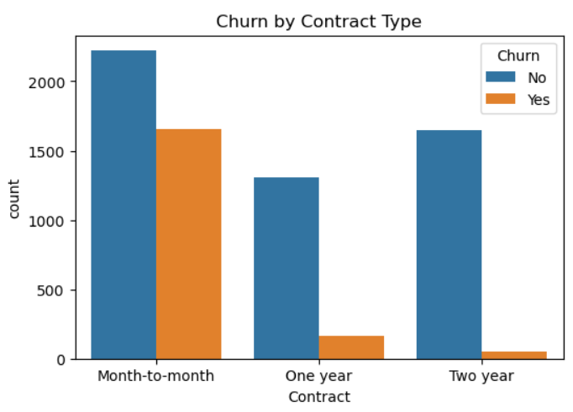
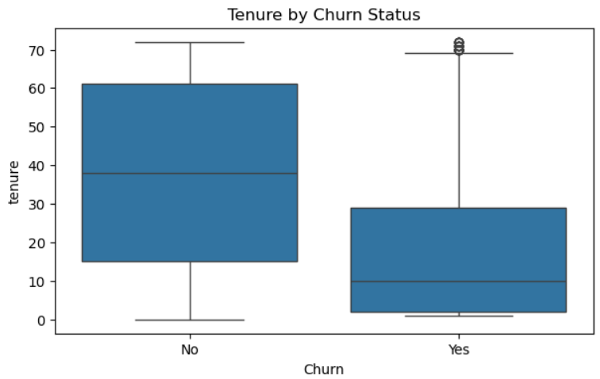
Exploratory Data Analysis (EDA)
There is a significant increase in churn rate with monthly contracts than with yearly contracts.
As tenure (in months) go up, rate of churn decreases.

Slide 7
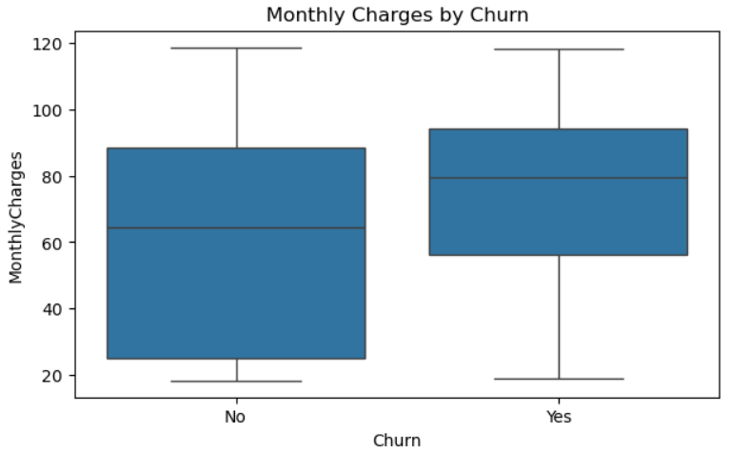
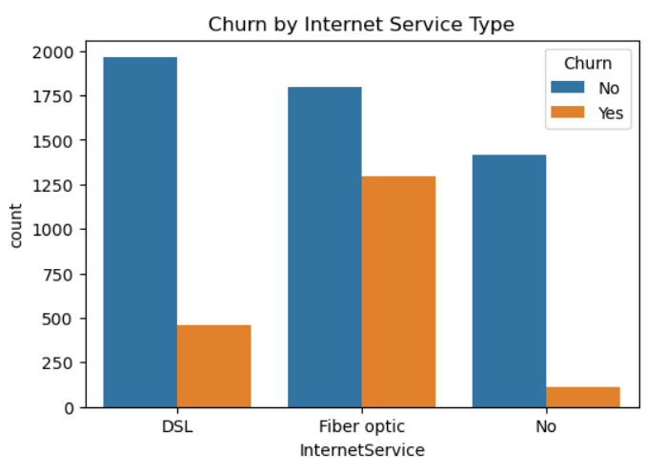
Exploratory Data Analysis (EDA) ((cont.))
Churn rates show a slight increase as monthly charges increase.
Fiber optic customers exhibit the highest churn rates, suggesting that higher-paying, high-speed users may also have higher expectations and greater sensitivity to pricing or service quality.

Slide 8
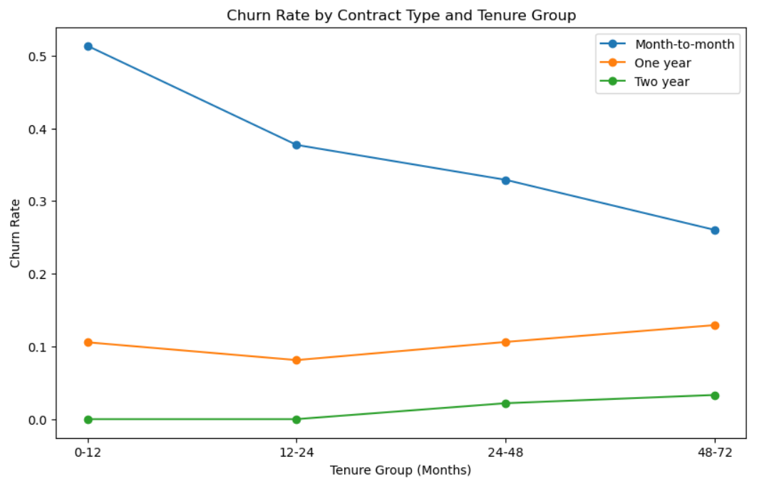
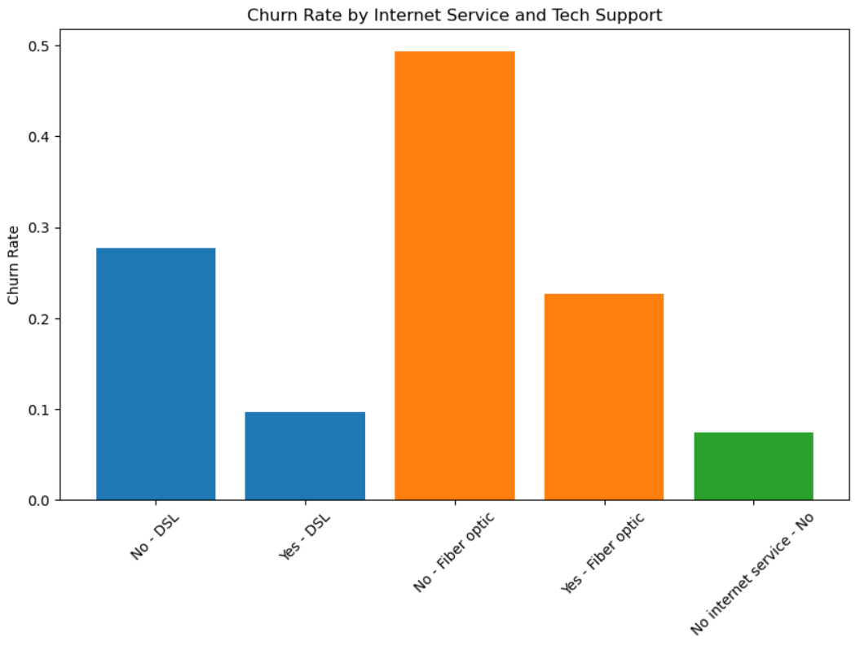
EDA(cont.) - Feature Interaction Analysis
Customers on monthly contracts churn at highest rate, however even long tenure monthly customers churn at higher rates than lower tenure customers on yearly contracts.
Customers with fiber optic service who do not have tech support demonstrate significantly higher churn rates compared to those who do.

Slide 9
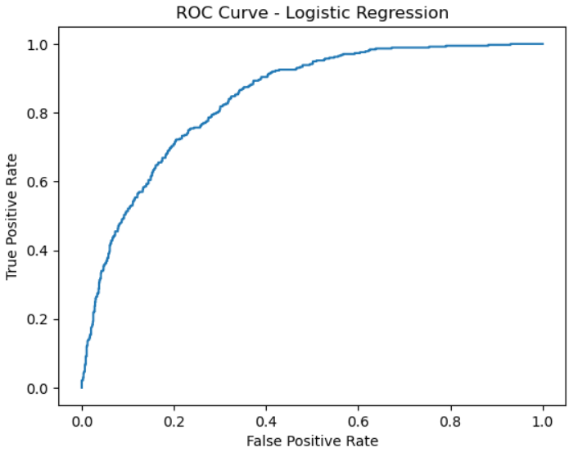
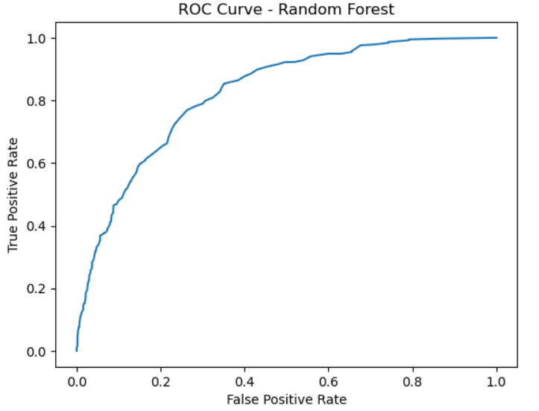
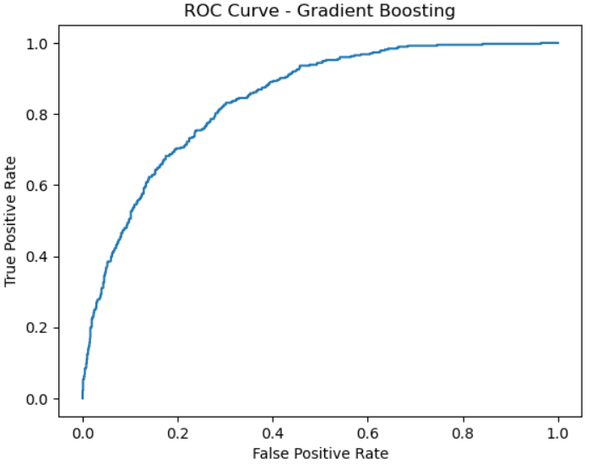
Modeling
Three classification models were trained to predict customer churn: Logistic Regression, Random Forest, and Gradient Boosting. Logistic Regression achieved the best performance with an Accuracy of 79.9% and ROC-AUC of 0.842, while Gradient Boosting performed nearly identically (Accuracy: 79.6%, ROC-AUC: 0.842) and Random Forest trailed slightly (Accuracy: 78.9%, ROC-AUC: 0.823).

Slide 10
Modeling (cont.)
Despite being the simplest model, Logistic Regression performed best, suggesting that churn in this dataset is largely driven by structured, additive relationships between customer attributes such as contract type, tenure, and pricing variables. This makes Logistic Regression both the most effective and most interpretable model, allowing stakeholders to clearly understand the drivers of churn while maintaining strong predictive performance.

Slide 11

Incorporating Findings
Why This Matters
Customer churn can be predicted with strong accuracy (ROC-AUC ≈ 0.84) using service and behavior data.
Customers with month-to-month contracts, short tenure, and higher monthly charges are more likely to leave.
Churn leads to lost revenue and higher customer acquisition costs, making retention critical.
What Shareholders / Telco Companies Can Do
Implement churn prediction systems to flag high-risk customers early.
Offer targeted retention incentives or service improvements to prevent churn.
Encourage customers to move from month-to-month to longer-term contracts.

Slide 12

Further Research Ideas
Incorporate additional behavioral data (service usage, support interactions, billing history) to improve predictions.
Test more advanced models such as XGBoost or LightGBM.
Use time-based approaches (e.g., survival analysis or time-series models) to predict when churn may occur.
Conduct customer segmentation analysis to identify churn patterns across different groups.

Slide 13

Thank You!
Questions or Discussions?

